Slide 1
For the Love of Animals
United Animal Services
Michael Amoo

Slide 2
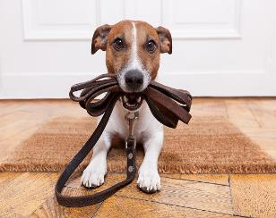
Meet our mascot, Daisy!

Slide 3
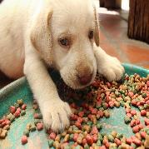
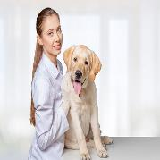
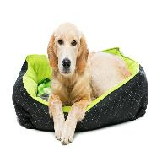
How we use your donations
Food
Medical
Shelter

Slide 4
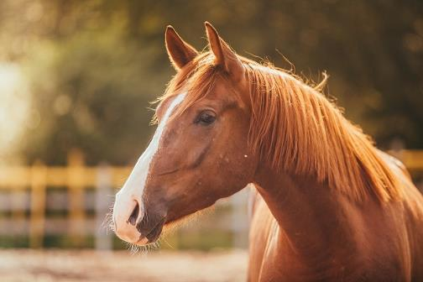
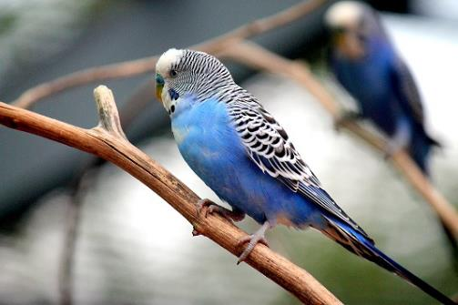
Big Red
Baby Blue

Slide 5
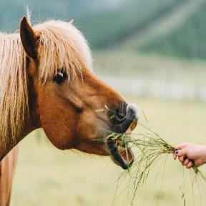
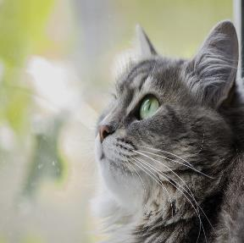

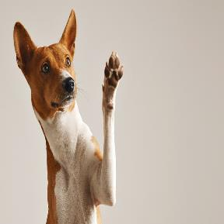

Every pet deserves a home
Every pet deserves a loving home

Slide 6

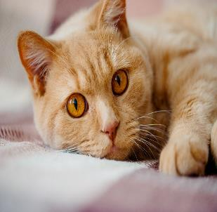
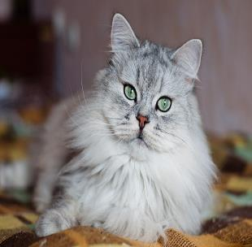
Purr-fect felines

Slide 7
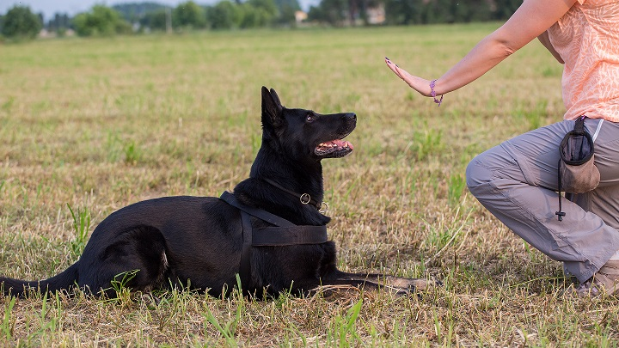
Training is an important part of what we do

Slide 8
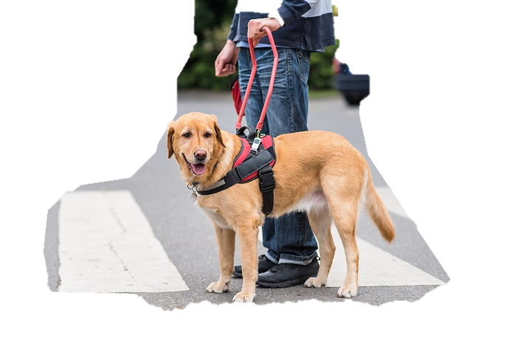
We train and provide service animals

Slide 9
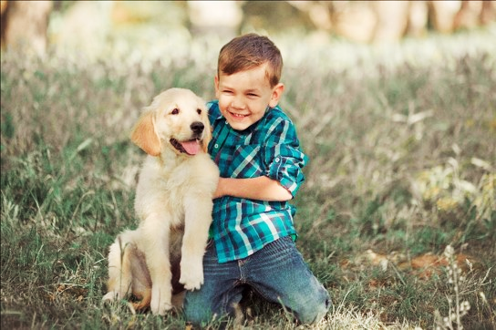
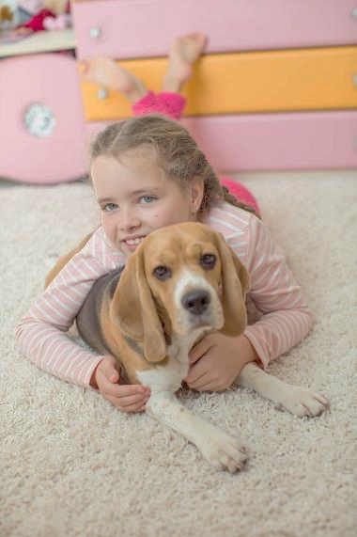
Kids love dogs

Slide 10
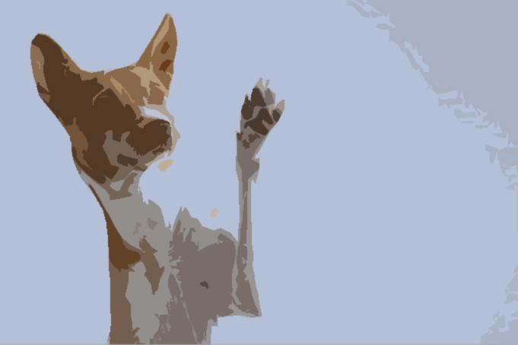
Am I your new best friend?

Slide 11
The adoption process
Animal
Animal arrives at UAS
Adopter
Wants a pet
Happy Family
Spend time together at UAS
Medical and behavioral exam
Can provide good care
Take animal home

Slide 12
How your dollars are used

Slide 13
Where we get our funding
Source | Average Yearly Amount
Wills and trusts | 500,000
Corporate donations | 375,000
Individual donations | 250,00
Charity events | 225,00
Anonymous donations | 100,000

